Slide 1
Chapter 4 Test Techniques
Author: PVANQUANG

Slide 2
Content
Categories of Test Techniques
Black-box Test Techniques
White-box Test Techniques
Experience-based Test Techniques

Slide 3
4.1 Categories of Test Techniques

Slide 4
4.1 Categories of Test Techniques
Categories of test techniques and their characteristics (K2)
Test techniques are used in test analysis, test design and test implementation activities
Use of test techniques can vary from very formal to very informal
In general, a combination of test techniques can achieve the best result.
A lot of factors can determine which test technique to choose, for example:
Component or system complexity | Tester knowledge and skills
Regulatory standards | Available tools
Customer or contractual requirements | Time and budget
Risk levels and types | Software development lifecycle model
Available documentation | The types of defects expected in the component or system

Slide 5
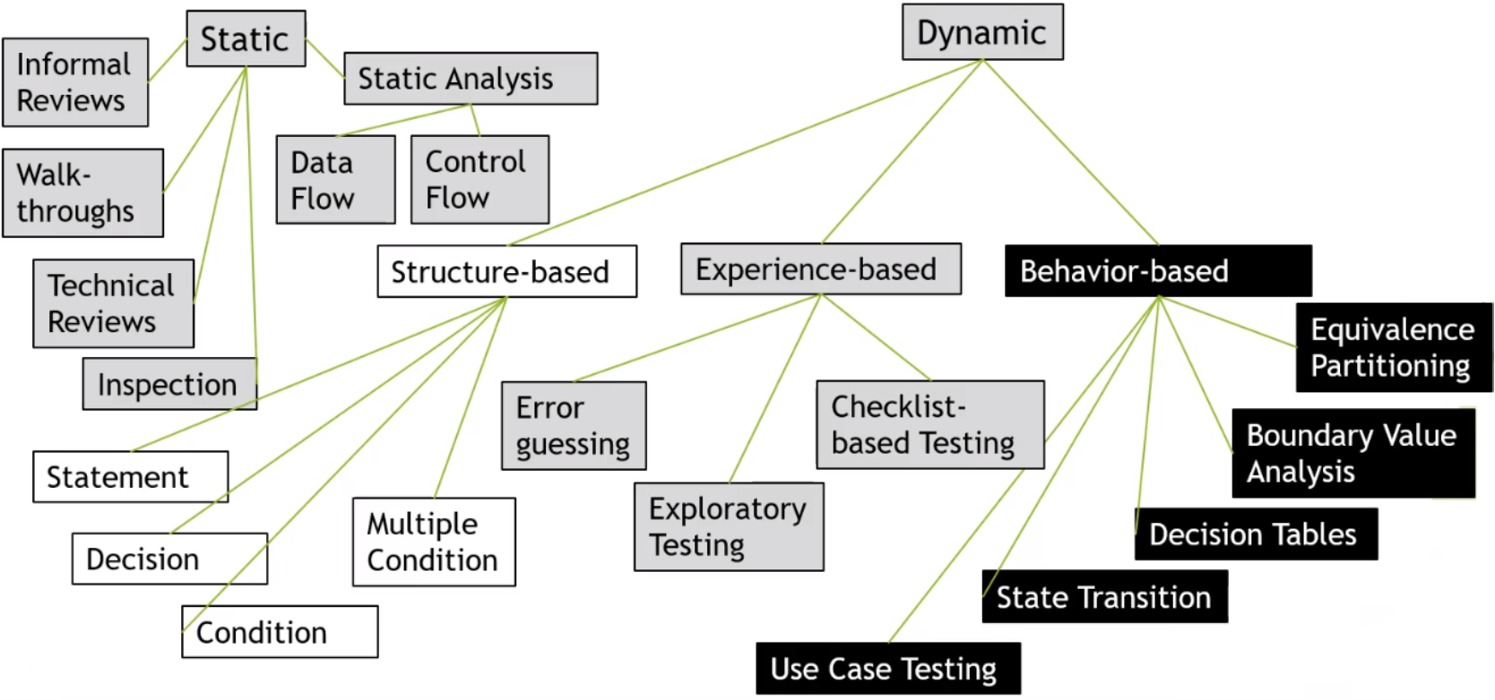
4.1 Categories of Test Techniques
Categories of test techniques and their characteristics (K2)

Slide 6

4.1 Categories of Test Techniques
Introduction (K2)

Slide 7
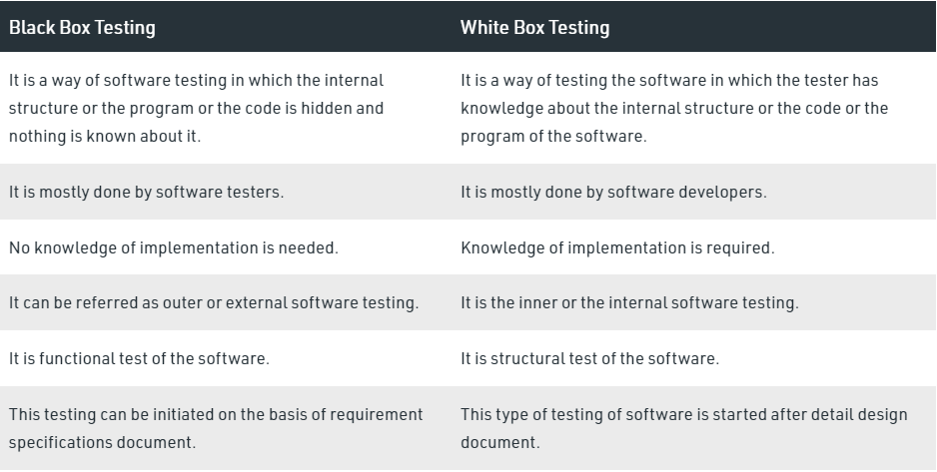
4.1 Categories of Test Techniques
Introduction (K2)

Slide 8
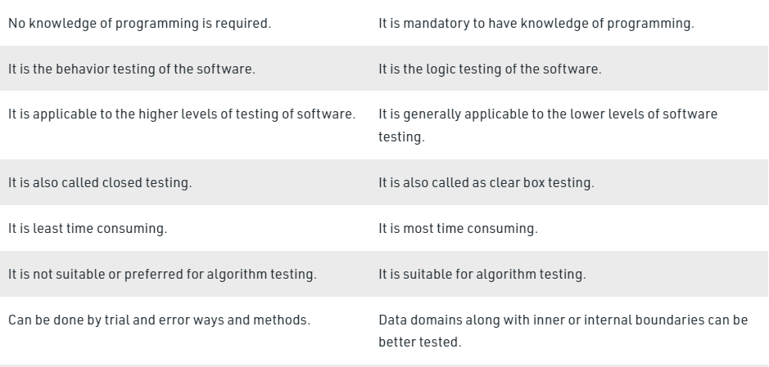
4.1 Categories of Test Techniques
Introduction (K2)

Slide 9
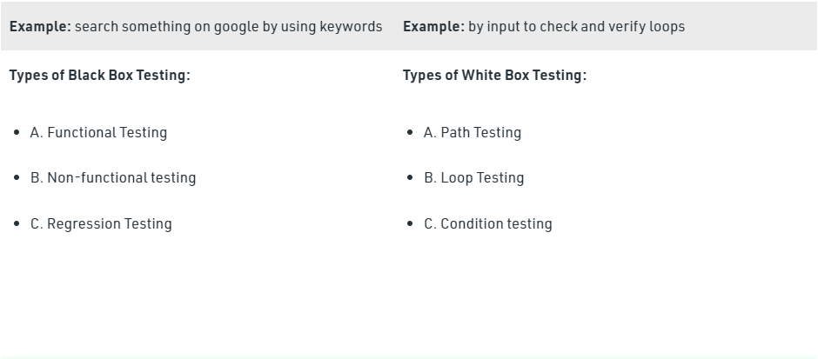
4.1 Categories of Test Techniques
Introduction (K2)
Requirement based,
behavioral or behavior-based
Structural or structure-based

Slide 10
4.2 Black-box Test Techniques

Slide 11
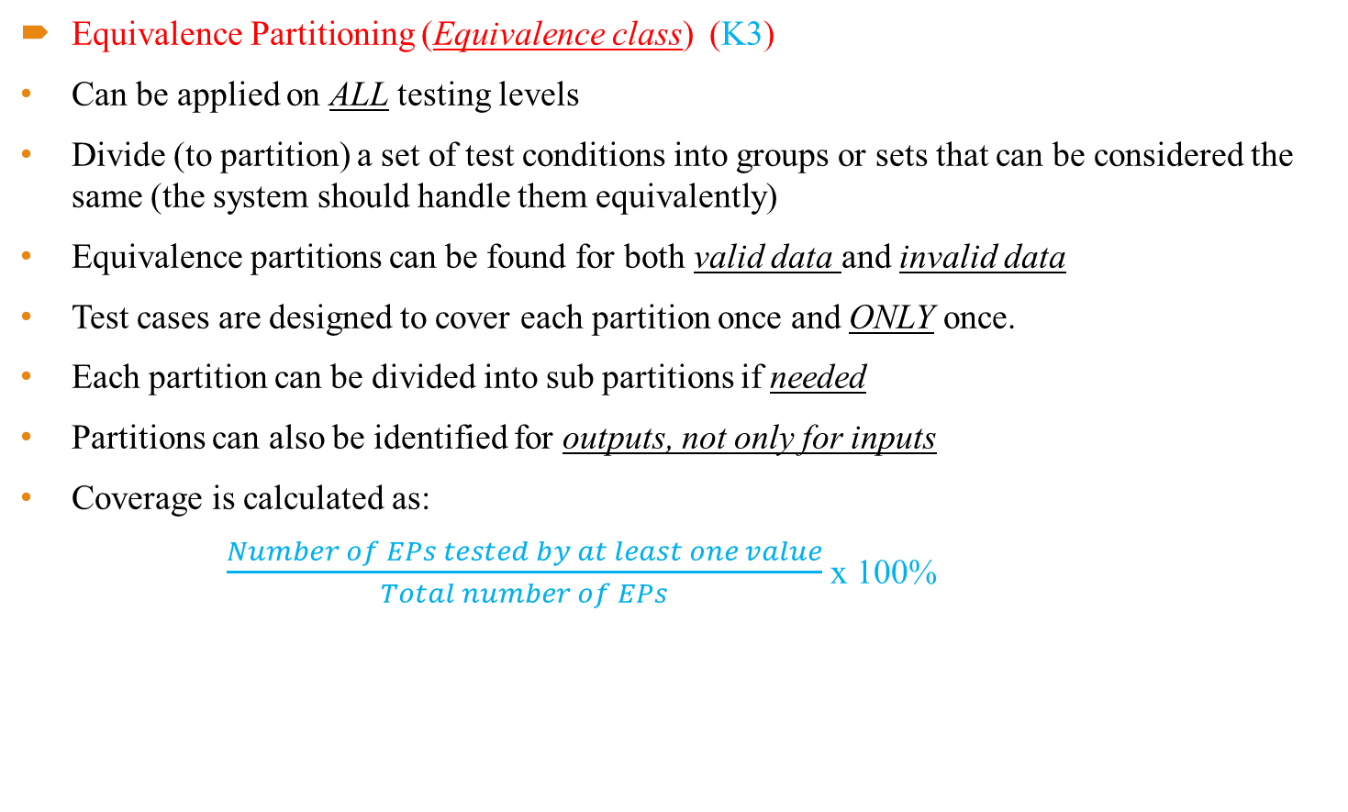
4.2 Black-box Test Techniques
Equivalence Partitioning (Equivalence class) (K3)
Can be applied on ALL testing levels
Divide (to partition) a set of test conditions into groups or sets that can be considered the same (the system should handle them equivalently)
Equivalence partitions can be found for both valid data and invalid data
Test cases are designed to cover each partition once and ONLY once.
Each partition can be divided into sub partitions if needed
Partitions can also be identified for outputs, not only for inputs
Coverage is calculated as:
$\frac{Number of EPs tested by at least one value}{Total number of EPs}$ x 100%

Slide 12
4.2 Black-box Test Techniques
Equivalence Partitioning (K3)
Example 1: Which of the following is a valid collection of equivalence partition for the following problem: “An integer field shall contain values from and including 1 to and including 15”
Less than 1, 1 through 15, more than 15
Negative numbers, 1 through 15, above 15
Less than 1, 1 through 14, more than 15
Less than 0, 1 through 14, 15 and more

Slide 13
4.2 Black-box Test Techniques
Equivalence Partitioning - Example (K3)
Example 2: In a system designed to work out the tax to be paid:
+ An employee has £4000 of salary tax free.
+ The next £1500 is taxed at 10%.
+ The next £28000 is taxed at 22%.
+ Any further amount is taxed at 40%.
Which of these groups of numbers would fall into the same equivalence class?
28001, 32000, 35000
5800, 28000, 32000
5200, 5500, 28000
4800, 14000, 28000

Slide 14
4.2 Black-box Test Techniques
Equivalence Partitioning - Example (K3)
Example 3: When setting a password, it can be between min 6 and max 10 characters.
How many test cases do you need for 100% Equivalence Partition coverage?

Slide 15
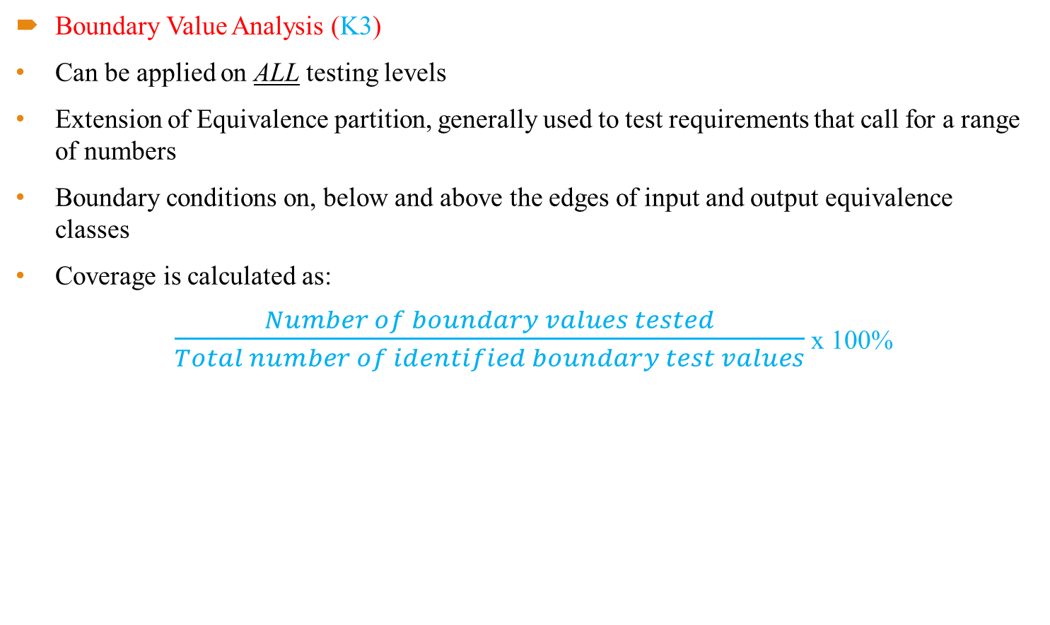
4.2 Black-box Test Techniques
Boundary Value Analysis (K3)
Can be applied on ALL testing levels
Extension of Equivalence partition, generally used to test requirements that call for a range of numbers
Boundary conditions on, below and above the edges of input and output equivalence classes
Coverage is calculated as:
$\frac{Number of boundary values tested}{Total number of identified boundary test values}$ x 100%

Slide 16
4.2 Black-box Test Techniques
Boundary Value Analysis (K3)
BVA 2-value: focused on testing at the minimum and maximum values of each partition
BAV 3-value (full BVA): focused on testing at the boundaries between partition PLUS both one value on either side of each boundary (as close as you can get)
Example: An integer field shall contain values from and including 1 to and including 15
Q1: Please give me the values that need to be tested when applying standard 2-value BVA, 3-value BVA
Q2: How many test cases would you need for full BVA and EP coverage?

Slide 17
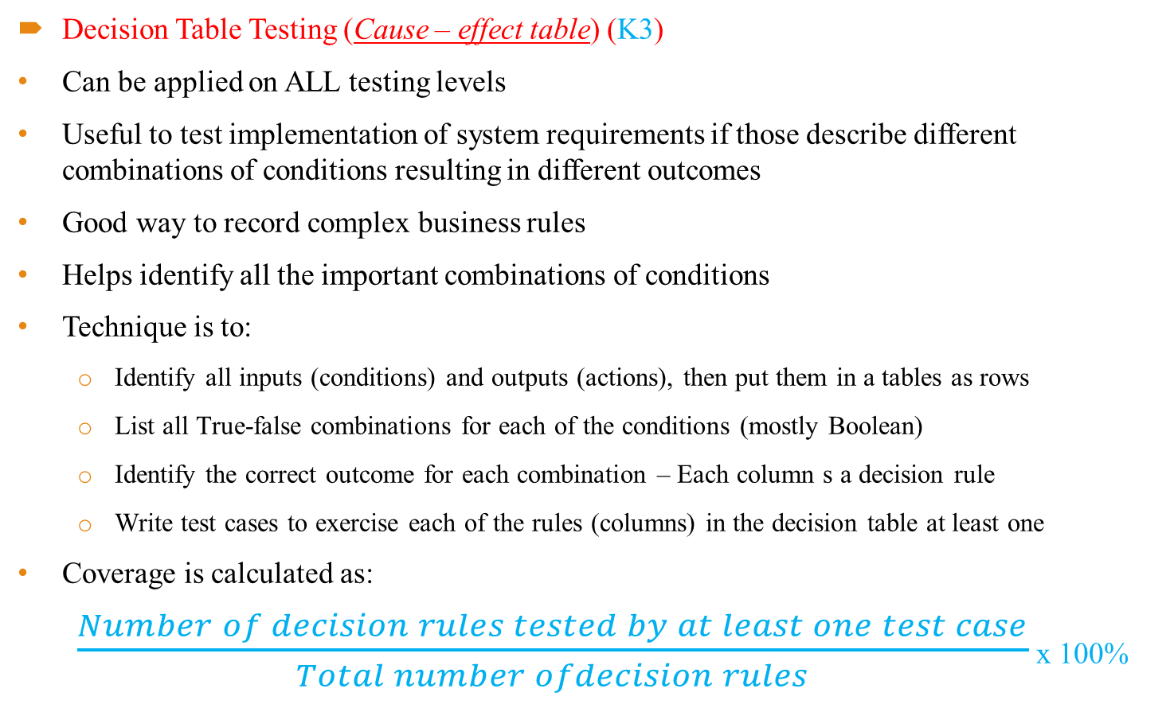
4.2 Black-box Test Techniques
Decision Table Testing (Cause – effect table) (K3)
Can be applied on ALL testing levels
Useful to test implementation of system requirements if those describe different combinations of conditions resulting in different outcomes
Good way to record complex business rules
Helps identify all the important combinations of conditions
Technique is to:
Identify all inputs (conditions) and outputs (actions), then put them in a tables as rows
List all True-false combinations for each of the conditions (mostly Boolean)
Identify the correct outcome for each combination – Each column s a decision rule
Write test cases to exercise each of the rules (columns) in the decision table at least one
Coverage is calculated as:
$\frac{Number of decision rules tested by at least one test case}{Total number ofdecision rules}$ x 100%

Slide 18
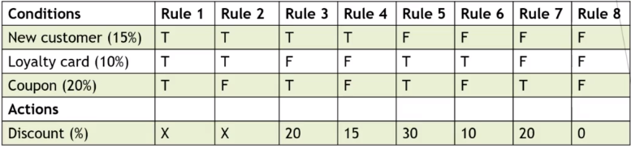
4.2 Black-box Test Techniques
Decision Table Testing - Example (K3)
Example 2: Opening a credit card account:
+ New customer, 15% discount on purchases today.
+ Existing customer and loyalty card, 10% discount on purchases today.
+ If you have a coupon, 20% discount on purchases today (not in combination with the new customer discount).
+ Discounts are added if applicable

Slide 19
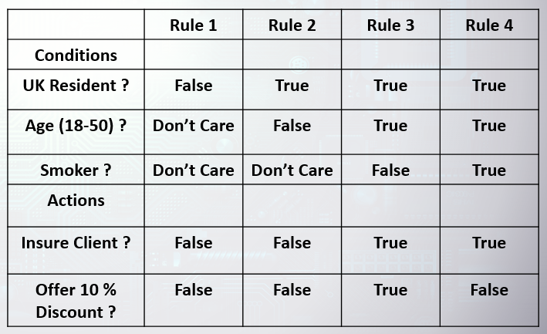
4.2 Black-box Test Techniques
Decision Table Testing (K3)
What is the expected result for each of the following test cases?
TC-A: Mr.A is a 32 year old, smoker, resident in London
TC-B: Mr.B is a 65 year old, non-smoker, resident in Paris
A – Insure, no discount, B – Don’t insure
A – Don’t insure, B – Don’t insure
A – Insure, no discount, B – Insure with 10% discount
A – Insure, 10% discount, B – Insure, no discount.

Slide 20
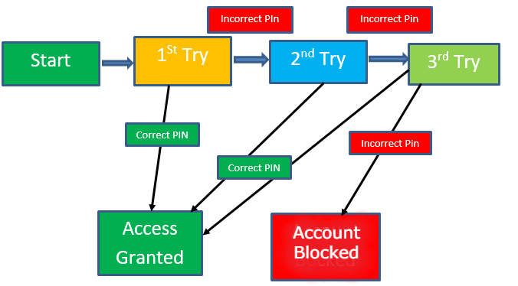
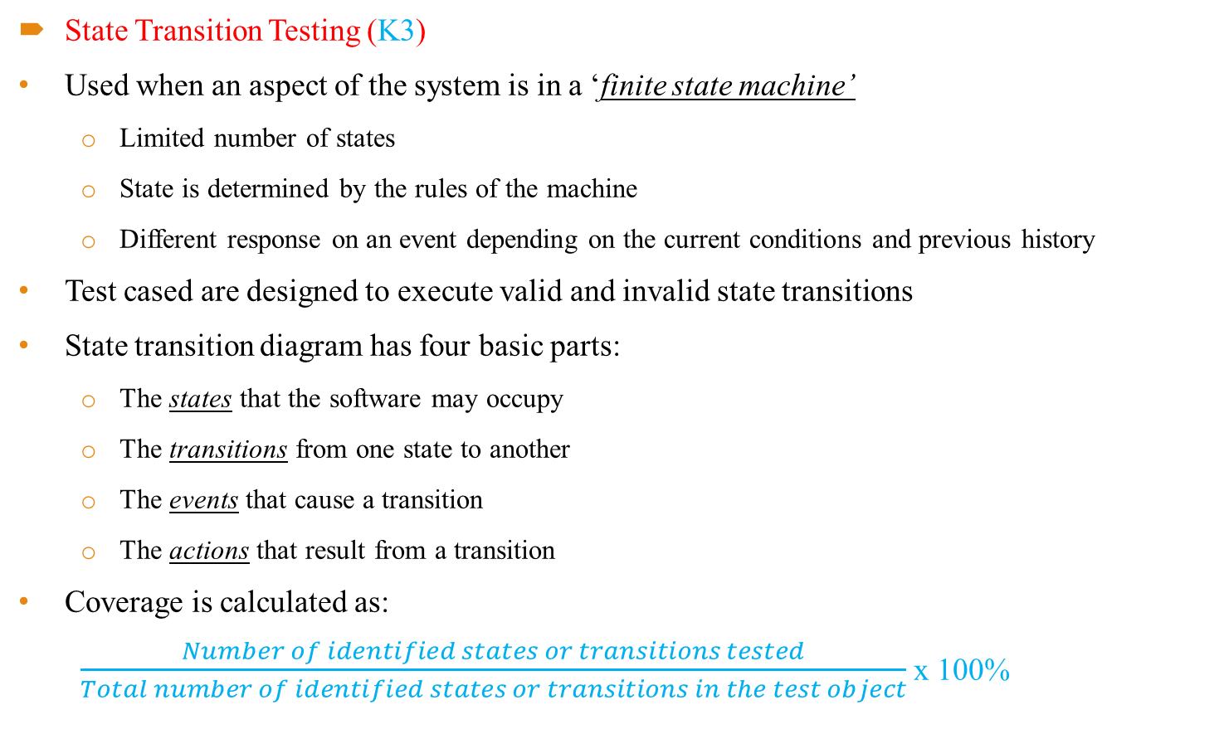
4.2 Black-box Test Techniques
State Transition Testing (K3)
Used when an aspect of the system is in a ‘finite state machine’
Limited number of states
State is determined by the rules of the machine
Different response on an event depending on the current conditions and previous history
Test cased are designed to execute valid and invalid state transitions
State transition diagram has four basic parts:
The states that the software may occupy
The transitions from one state to another
The events that cause a transition
The actions that result from a transition
Coverage is calculated as:
$\frac{Number of identified states or transitions tested}{Total number of identified states or transitions in the test object}$ x 100%

Slide 21
4.2 Black-box Test Techniques
State Transition Testing - Example (K3)
Let’s take a simplified ATM process:
Insert the card -> wait for the PIN screen to come up
-> enter PIN, if correct, you have access to the account
-> if incorrect, try again
-> if incorrect after the 3rd try, the ATM eats the card
Q1: Please draw the State Transition Diagram with the states and the transitions
Q2: Please draw the State Transition Table
Q3: How many test cases do you need to test all states and please specify the test case?
Q4: How many test cases do you need to test all transitions and please specify the test case?
Q5: Please give two examples of invalid transitions

Slide 22
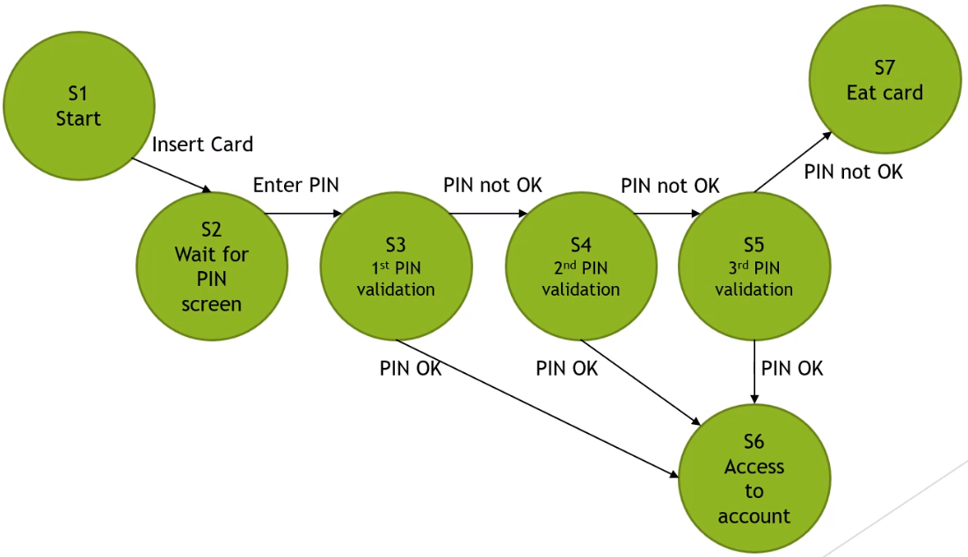
4.2 Black-box Test Techniques
State Transition Testing - Example (K3)
Q1: Please draw the State Transition Diagram with the states and the transitions

Slide 23
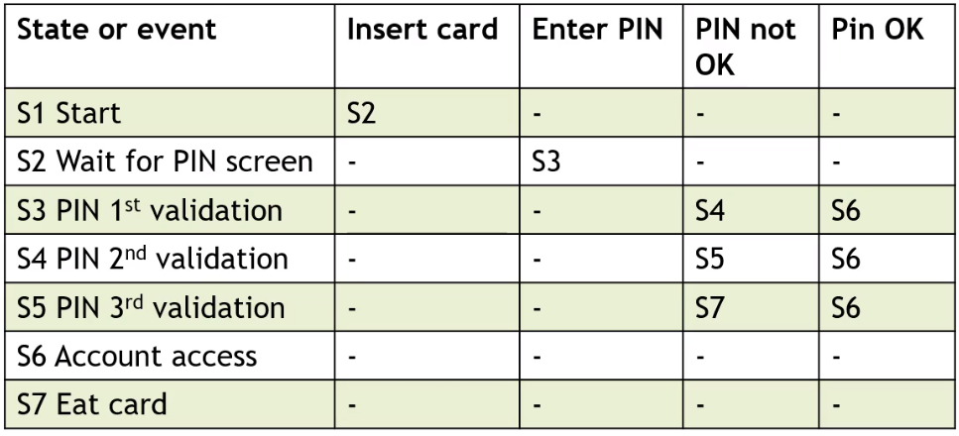
4.2 Black-box Test Techniques
State Transition Testing - Example (K3)
Q2: Please draw the State Transition Table

Slide 24
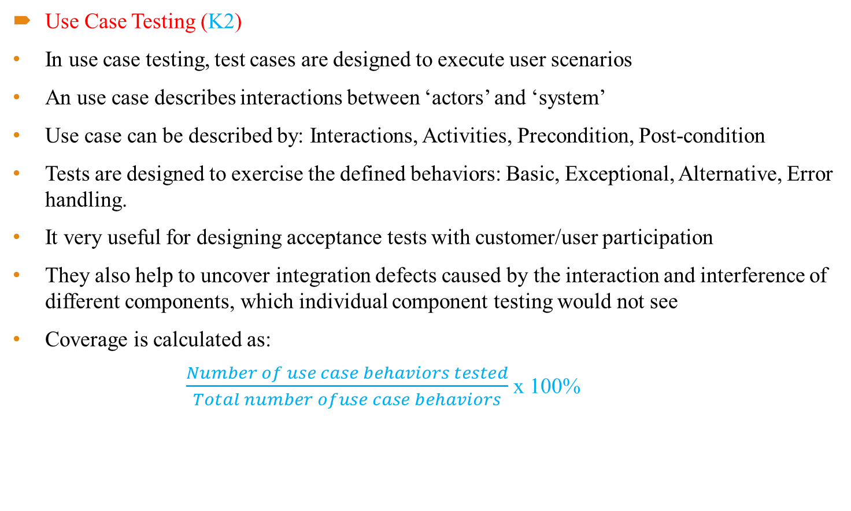
4.2 Black-box Test Techniques
Use Case Testing (K2)
In use case testing, test cases are designed to execute user scenarios
An use case describes interactions between ‘actors’ and ‘system’
Use case can be described by: Interactions, Activities, Precondition, Post-condition
Tests are designed to exercise the defined behaviors: Basic, Exceptional, Alternative, Error handling.
It very useful for designing acceptance tests with customer/user participation
They also help to uncover integration defects caused by the interaction and interference of different components, which individual component testing would not see
Coverage is calculated as:
$\frac{Number of use case behaviors tested}{Total number ofuse case behaviors}$ x 100%

Slide 25
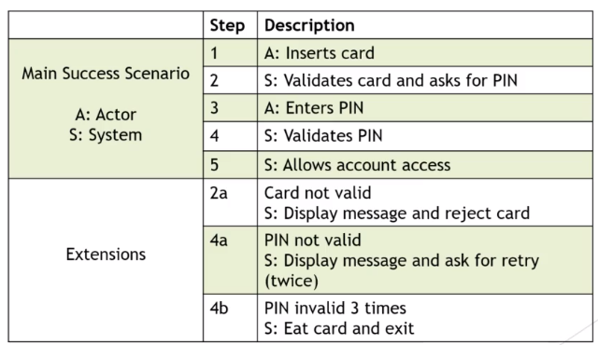
4.2 Black-box Test Techniques
Use Case Testing - Example (K2)
Use case:
- Actor inserts the card,
- System validates the card and asks for the PIN.
- Actor enters PIN and System validates the PIN.
- If valid, account access is granted.
- If invalid, a message is shown and the card is rejected.
- After the 3 incorrect PIN attempts, the cart is eaten.

Slide 26
4.3 White-box Test Techniques

Slide 27
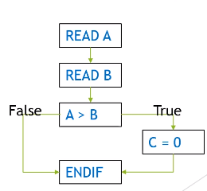
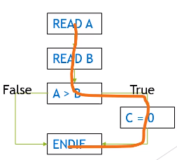
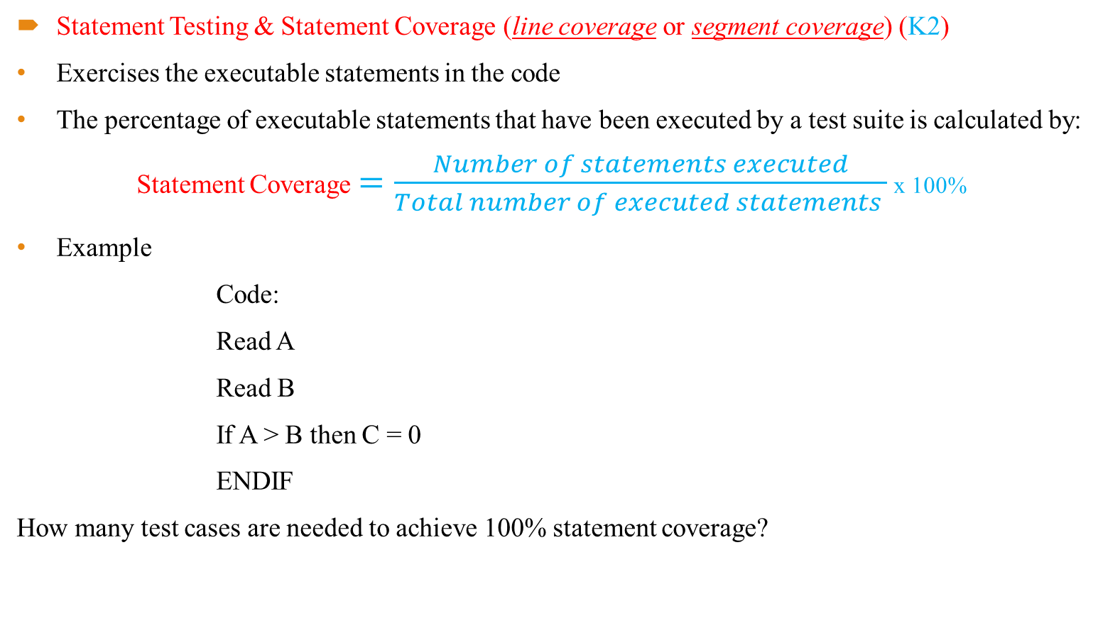
4.3 White-box Test Techniques
Statement Testing & Statement Coverage (line coverage or segment coverage) (K2)
Exercises the executable statements in the code
The percentage of executable statements that have been executed by a test suite is calculated by:
Statement Coverage $=\frac{Number of statements executed}{Total number of executed statements }$ x 100%
Example
Code:
Read A
Read B
If A > B then C = 0
ENDIF
How many test cases are needed to achieve 100% statement coverage?

Slide 28
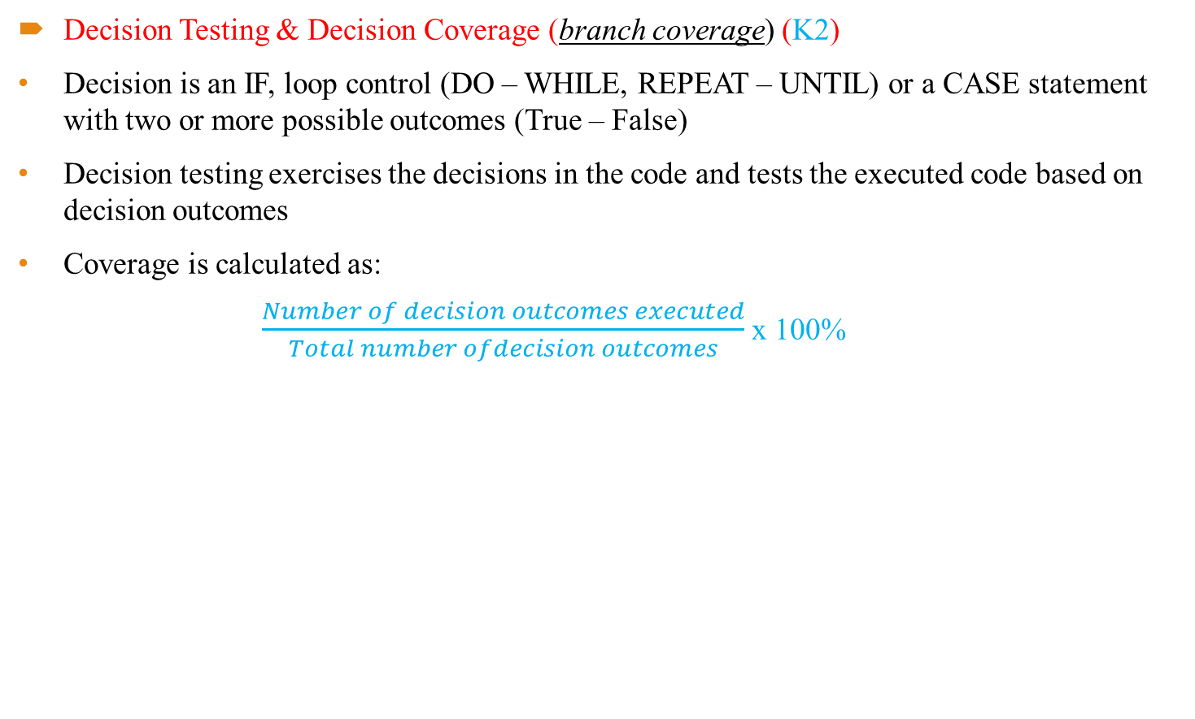
4.3 White-box Test Techniques
Decision Testing & Decision Coverage (branch coverage) (K2)
Decision is an IF, loop control (DO – WHILE, REPEAT – UNTIL) or a CASE statement with two or more possible outcomes (True – False)
Decision testing exercises the decisions in the code and tests the executed code based on decision outcomes
Coverage is calculated as:
$\frac{Number of decision outcomes executed}{Total number ofdecision outcomes}$ x 100%

Slide 29
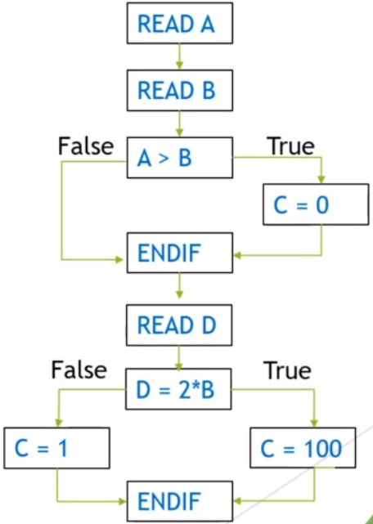
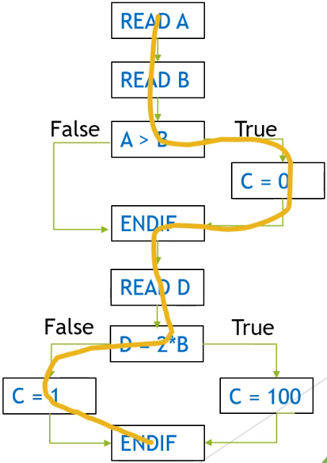
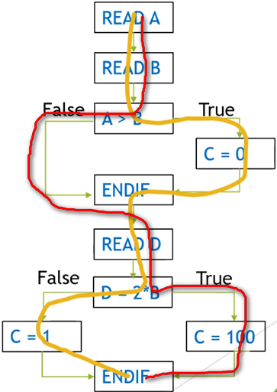
4.3 White-box Test Techniques
Decision Testing & Decision Coverage – Example (K2)
Example:
READ A
READ B
IF A > B THEN C = 0
ENDIF
READ D
If D = 2*B THEN C = 100
ELSE C = 1
ENDIF
Q1: What is the decision coverage with A = 12, B = 10, D = 5?
Q2: How many TC are needed to achieve 100% decision coverage?

Slide 30
4.3 White-box Test Techniques
The Value of Statement and Decision Testing (K2)
100% statement coverage:
Ensures all executable statements have been tested at least once
DON’T ensure that all decision logic has been tested
Provide less coverage than decision testing
Helps to find defects in code that was not exercised by other tests
100% decision coverage:
Ensures all decision outcomes and all executable statements
Includes all TRUE and FALSE outcomes, even if implied
Helps to find defects in code where other tests have not taken both true and false outcomes
Achieving 100% decision coverage guarantees 100% statement coverage (but not vice versa)

Slide 31
4.3 Experience-based Test Techniques

Slide 32

4.4 Experience-based Test Techniques
Error Guessing (K2)
A technique used to anticipate the occurrence of errors, defects, and failures, based on the tester’s knowledge, including:
How the application has worked in the past
What kind of errors tend to be made
Failures that have occurred in other applications
No rules, tester is encouraged to think of situations the software will not be able to cope
Methodical approach:
Create a list of possible errors, defects, and failures, and design tests that will expose those failures and the defects that caused them
These error, defect, failure lists can be built based on experience, defect and failure data, or from common knowledge about why software fails
Example: input data into a date field ( Feb 29, JP data format, European data format)

Slide 33
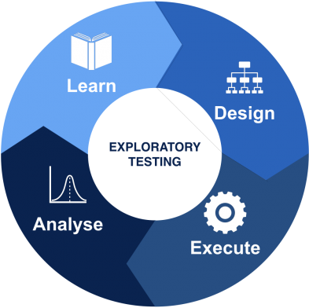
4.4 Experience-based Test Techniques
Exploratory Testing (K2)
Informal test technique
During test execution, the tester designs, executes, logs and evaluates tests
Is used to learn more about a component or system and create tests for areas that need more testing
Can be conducted using session-based testing:
Defined time-box
May use session sheets to document the steps and the discoveries
Most useful when there are few or inadequate specifications or significant time pressure on testing
Also useful to complement other more formal testing techniques
Strongly associated with reactive test strategies
Can include the use of other black-box, white-box, and experience-based techniques

Slide 34

4.4 Experience-based Test Techniques
Checklist-based testing (K2)
Testers design, implement, and execute tests to cover test conditions found in a checklist
Testers create a new checklist or expand an existing checklist, but testers may also use an existing checklist without modification
Checklists can be built based on experience, knowledge about what is important for the user, or an understanding of why and how software fails
Checklists can be created to support various test types, including functional and non-functional testing
If there are no detailed test cases, checklist can provide guidelines and consistency.
Checklist are high-level lists, so variability will most likely occur, resulting in:
Greater coverage
Less repeatability

Slide 35


